Slide 1

Welcome
Presentation on Project Idea
for PGDAC Course Sep. 2022 Batch B

Slide 2
Project Title:- eLaundryBasket (The Laundry Management System)
Project Team Members
(PGDAC Sep.2022 Batch B):
1) Mahesh Sagare(222019118)
2) Sahil Khan(222019119)
3) Saurabh Bramhankar(222019125)
4) Vikrant Sonawane(222019152)

Slide 3
Aim Of Project To Design And Implementation Of A Laundry Management System (LMS) Used In A Laundry Establishment.

Slide 4
Problems Observed:
Difficulties in keeping detailed records of customers clothing.
Manual Cleaning services results in waste or inefficiency of time, data inaccuracies, errors are repeated frequently.
Manually go to laundry and requesting for a service is time consuming for user

Slide 5

So eLaundryBasket ,
will help to both customers and Laundry firms in all above problems

Slide 6
Services we will provide:
Connect with people online and provide services related to laundry.
Information and records of Laundry we will be managed in an efficient and cost wise fashion so that the organization resources may be effectively utilized.
Automate the management of the laundry firm making it more efficient and error free.
Using this system the client can post an order for a particular laundry service without actually going to the laundry shop
Customer can post an order according to his convenience of day and time.
Customer can view the status of his order, view the price list of the particular services.

Slide 7
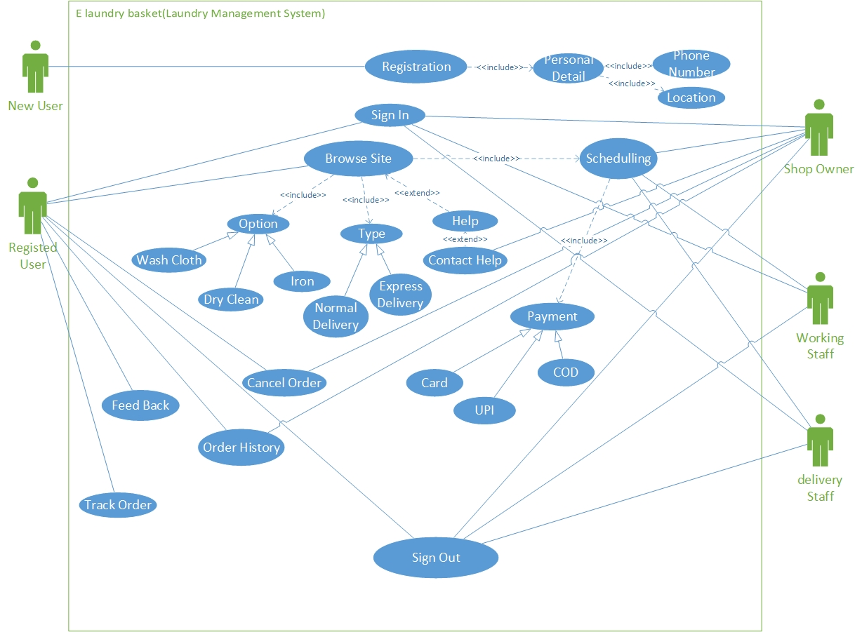
Use Case Diagram:

Slide 8







Technologies used:
Front end-
Back end-
Database-

Slide 9
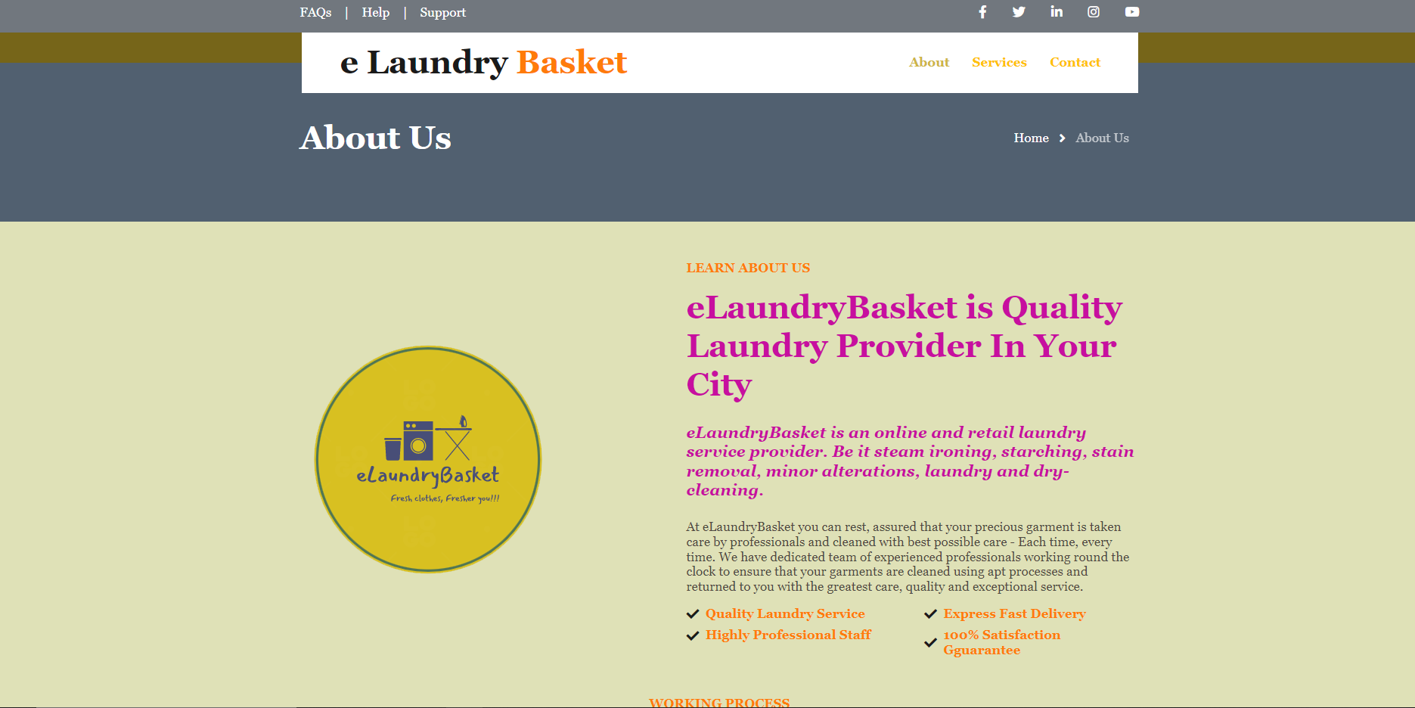
Sample Page:

Slide 10
Conclusions
This system will:
Automate the entire system improves the efficiency.
It provides a friendly graphical user interface which proves to be better when compared to the existing manual system.
It effectively overcomes the delay in communications.
Updating of information becomes so easier

Slide 11
Suggetions please!!!

Slide 12
Thank You!!!

